Slide 1

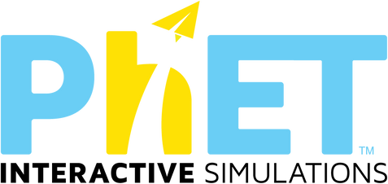
SIMULATION SOFTWARES
MODELLING AND SIMULATION
CO-207
PRESENTED BY :
SANDESH SHRESTHA 2K21/CO/417
SANSKAR OJHA 2K21/CO/418
SUBMITTED TO :
Ms. Dipika Jain Ma’am

Slide 2
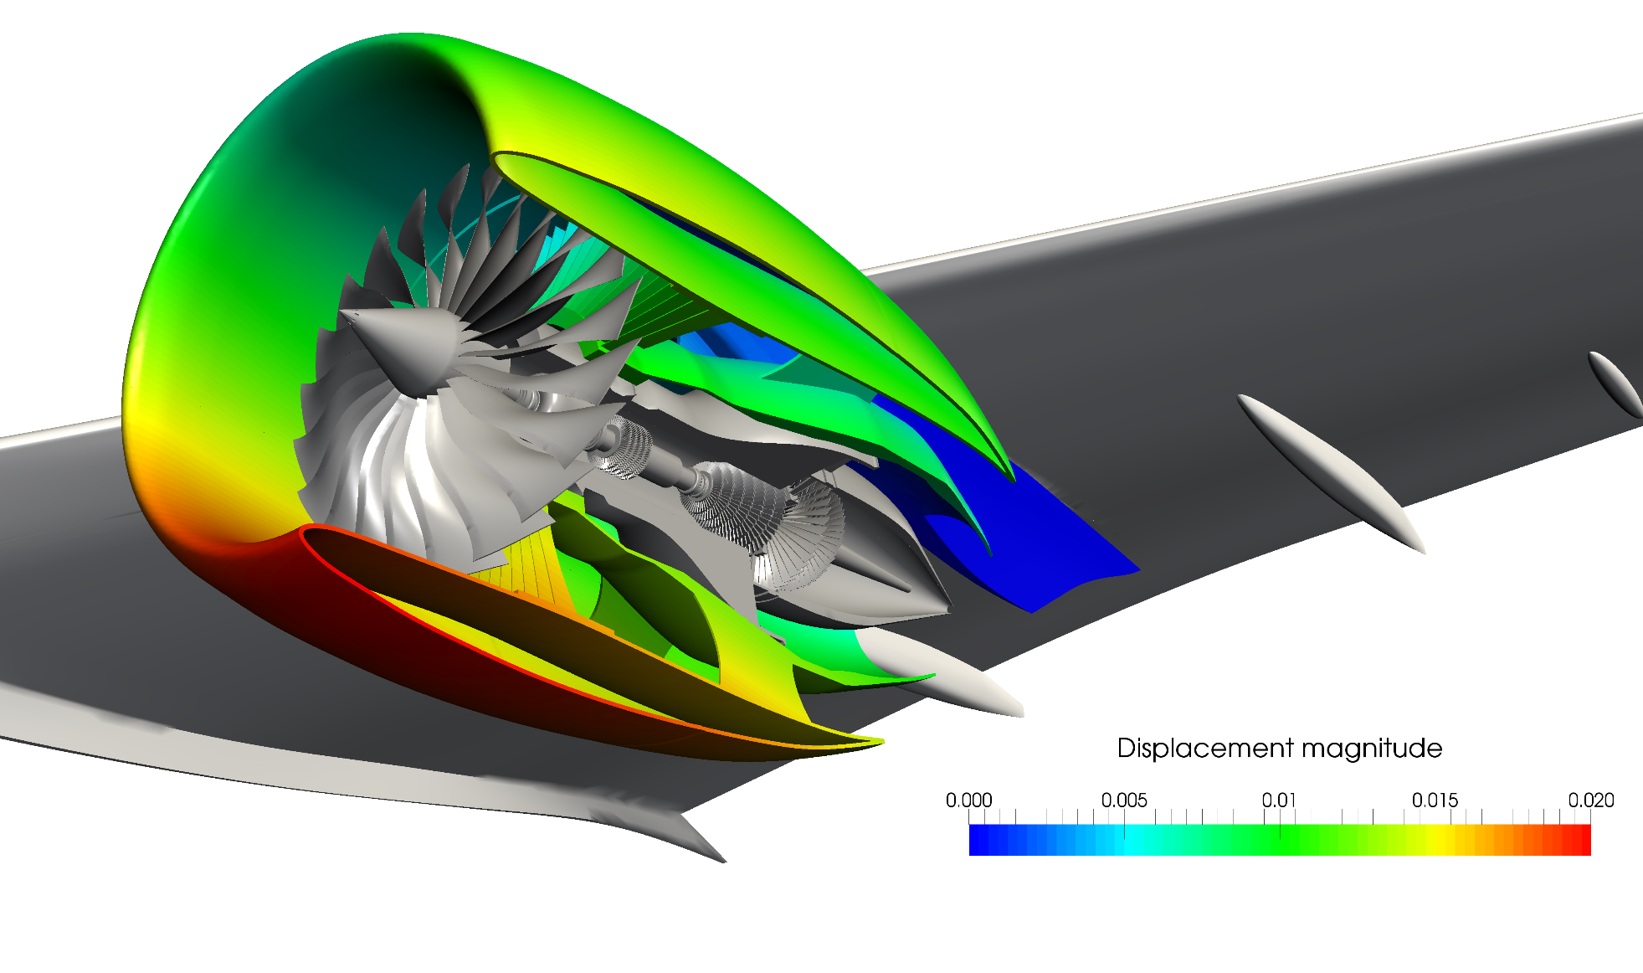
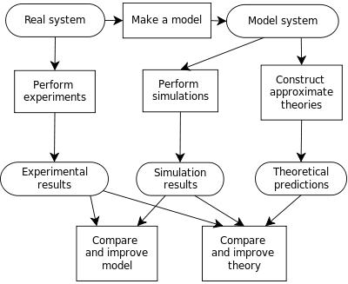
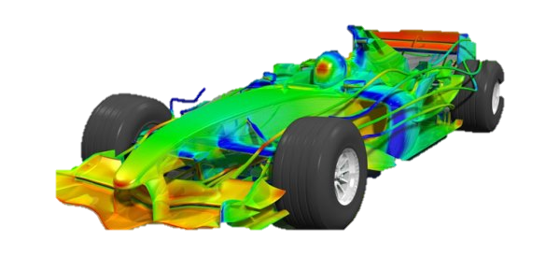
SIMULATION
a model or representative example of something.
Basically, a model that duplicates how an existing or
proposed systems work, providing evidence for
decision-making by allowing the testing of various scenarios or process improvements.

Slide 3
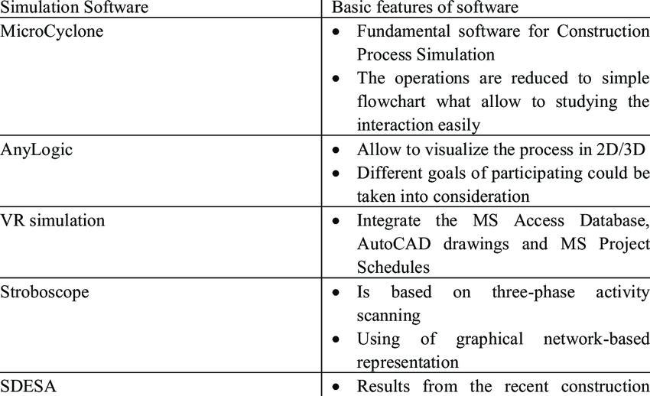
Classification of simulation software:
General purpose and Application-oriented simulation packages

Slide 4

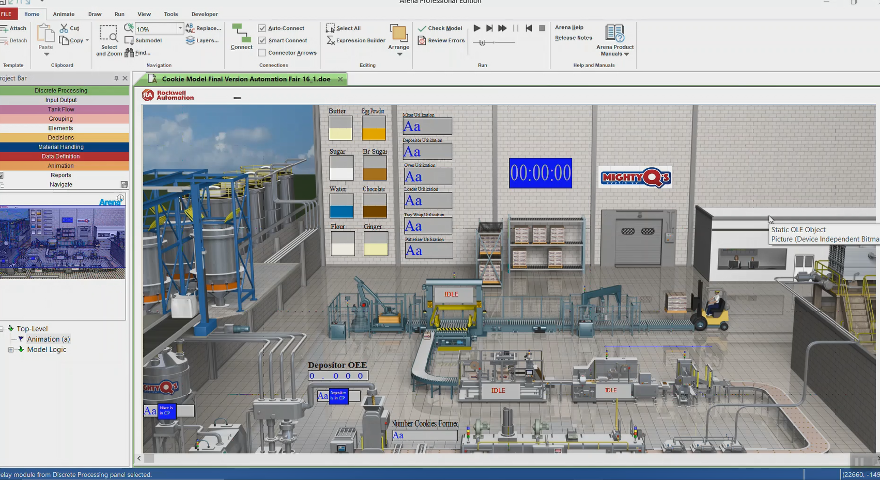
Arena is a simulation software product that provides an integrated framework for building simulation models in a wide variety of applications.
Arena can be used to model any system within the manufacturing or service industries.
Logistics operations, such as warehousing and transportation
Banks and ATMs
Vehicle planning and scheduling
Supply chain
Business process (eg insurance office, call centre)

Slide 5

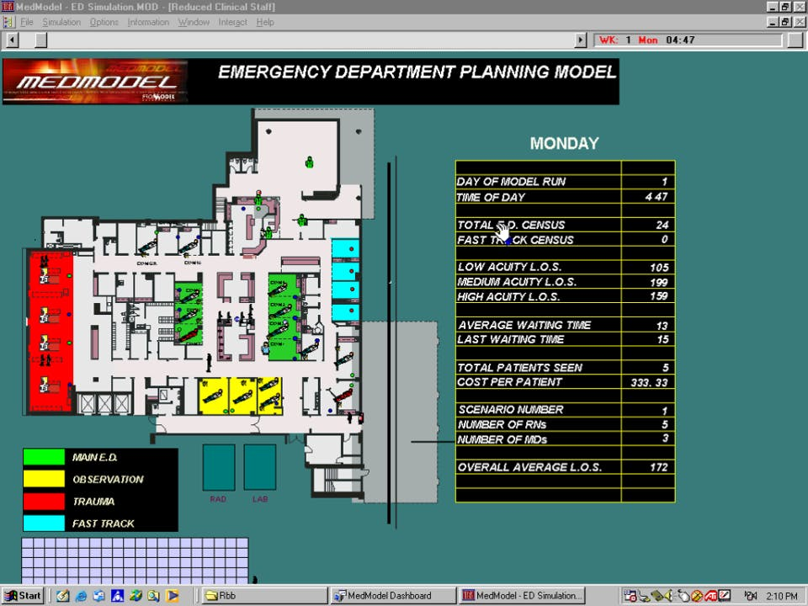
a powerful Windows-based simulation tool for simulating and analyzing health care systems of all types and sizes.
provides the perfect combination of ease-of-use and complete flexibility and power for modeling nearly any situation, and its realistic animation capabilities makes simulation come to life.
Facility planning
Health care policy formulation
Staffing & equipment requirements planning
Disaster planning
Managed care analysis

Slide 6
Features for Simulation Software:
General capabilities
Hardware and software considerations
Animation
Statistical features
Customer support and documentation
Output reports and plots

Slide 7
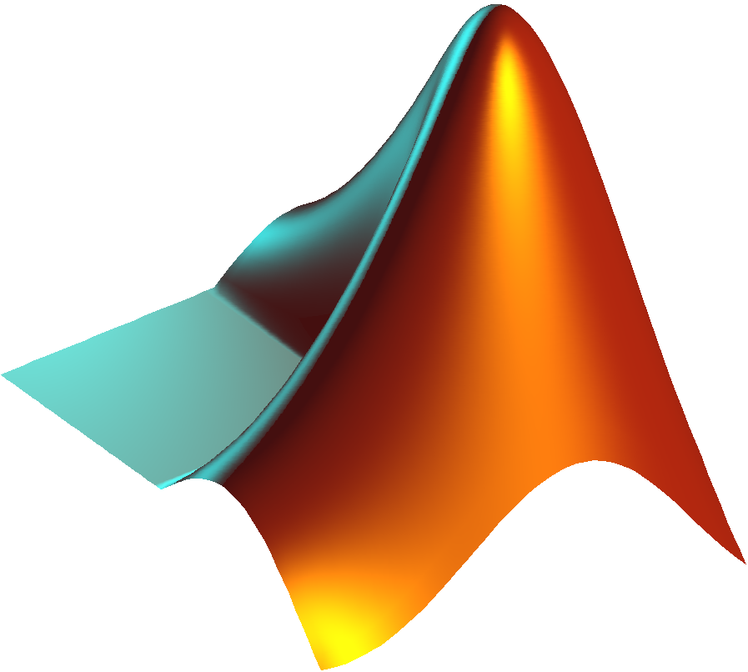






Some Popular Simulation Softwares
Fusion 360
MATLAB

Slide 8
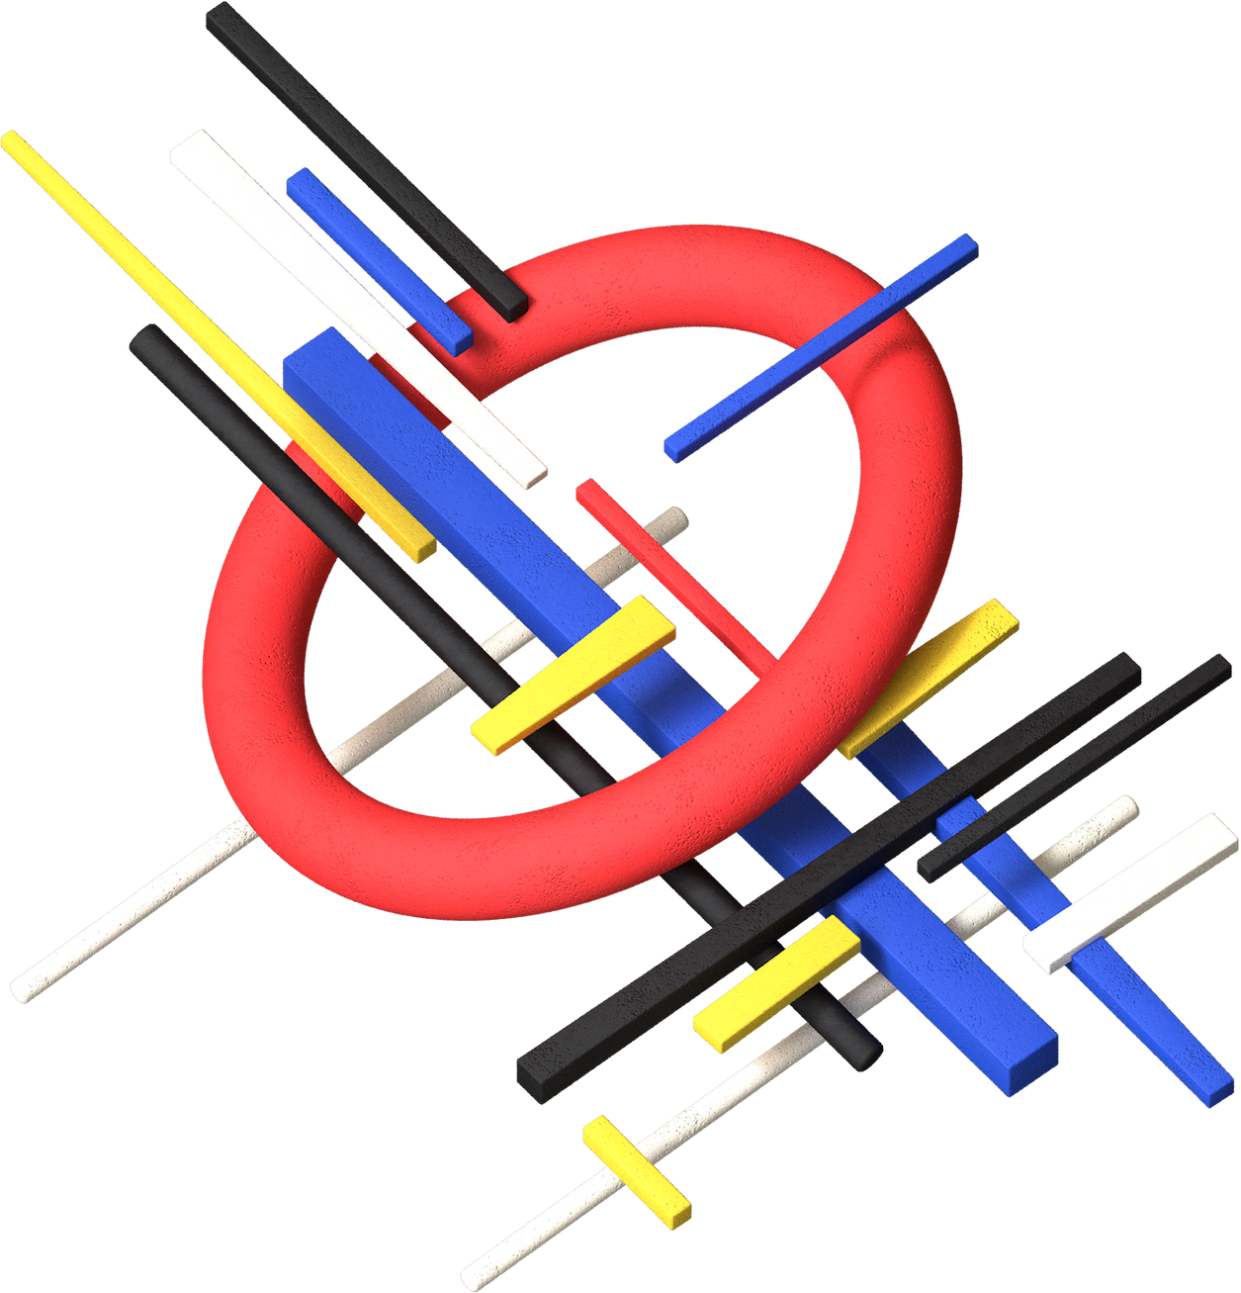
PhET Interactive Simulations
an open source project, which has benefited from the contributions of other open source projects.
stands for Physics Education Technology Founded in 2002 by Nobel Laureate Carl Wieman, the PhET Interactive Simulations project at the University of Colorado Boulder creates free interactive math and science simulations.
PhET simulations provide fun, interactive research-based simulations for use in K-12 and college STEM education.
helps students visually comprehend concepts, PhET simulations animate what is invisible to the eye through the use of graphics and intuitive controls such as click-and-drag manipulations, sliders and radio buttons.

Slide 9
HTML5 Source Code
Java/Flash/Flex Source Code (Legacy)
Since 2013, PhET sims have been developed in HTML5. The PhET HTML5 and JavaScript source code lives on the PhET page.
Initially it was developed with help of Javascript and typescript but now this project no longer supports any legacy Java, Flash, or Flex source code. This source code lives in a Subversion repository.

Slide 10
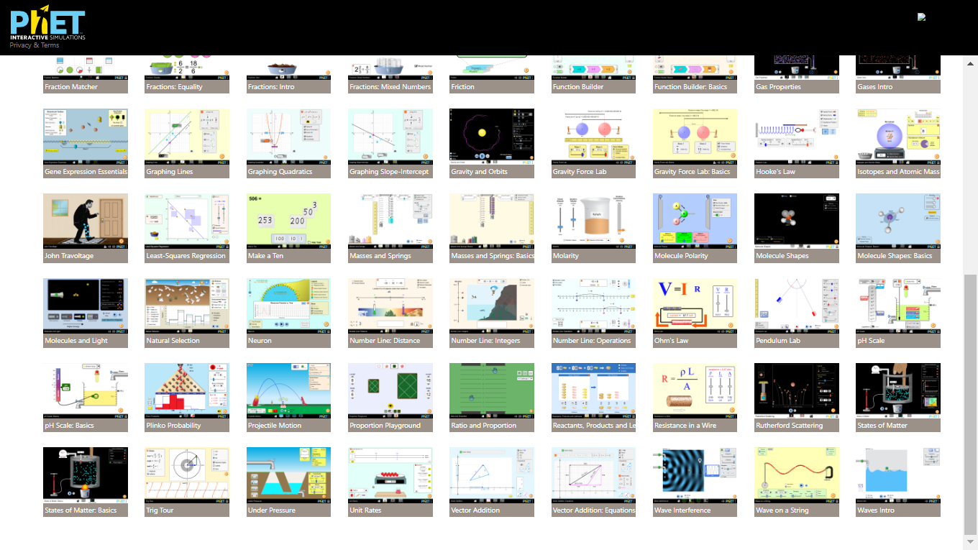

Slide 11
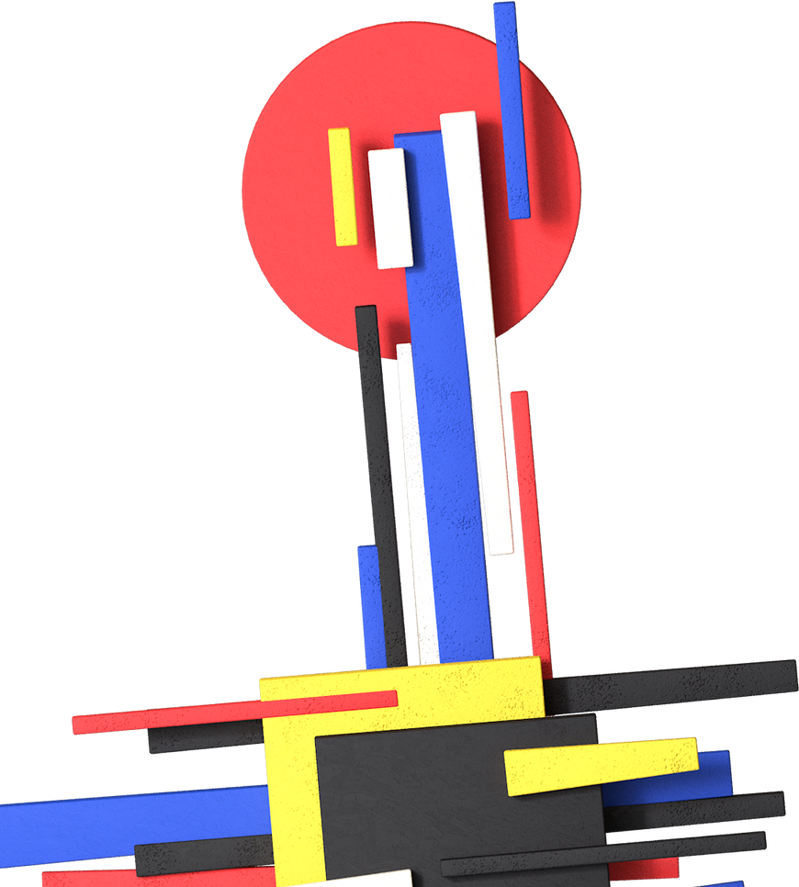
Advantages of PhET simulation
Encourage scientific inquiry
Provide interactivity
Make the invisible visible
Show visual mental models
Include multiple representations (e.g., object motion, graphs, numbers, etc.)
Use real-world connections
Give users implicit guidance (e.g., by limiting controls) in productive exploration
Create a simulation that can be flexibly used in many educational situations

Slide 12
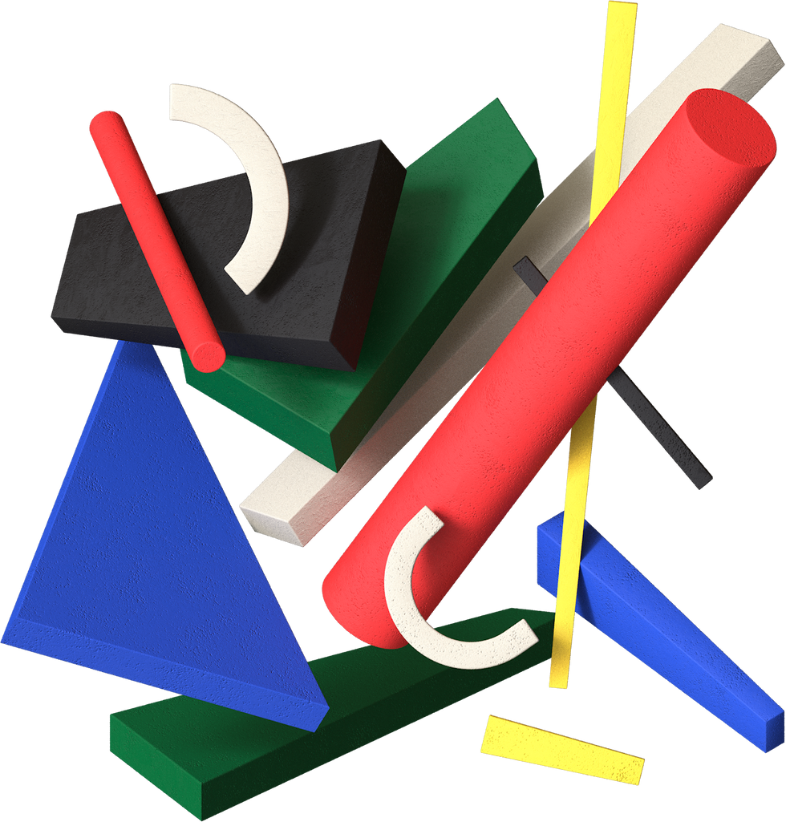
Complexity of simulation development
Development Of PhET simulation
As a reference point, a moderately complex PhET simulation requires 160 hours of design, 500+ hours of software development, and 40 hours of testing. It requires expertise in design and in JavaScript/typescript
Evolution of the PhET code base
The PhET code base is a work-in-progress, with constant evolution and improvement. it work directly on their master copy. In addition PhET do not announce breaking API changes, nor publish change logs for their codebase
GPL licensing requirements when customizing existing PhET simulations
Any customization made to PhET simulations will need to comply with licensing requirements. Most of PhET’s simulation-specific repositories are licensed under GPL, requiring any modified simulations to also be licensed under GPL

Slide 13

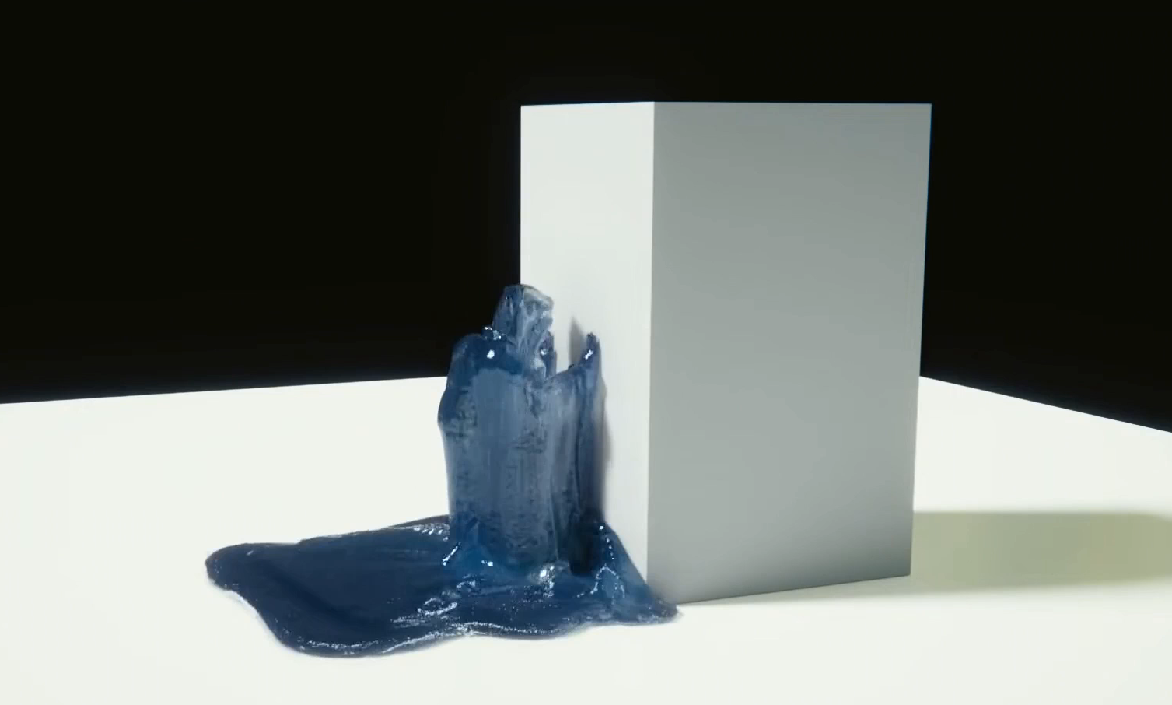

BLENDER
https://www.blender.org/
free and open source 3D creation suite.
modeling, rigging, animation, simulation, rendering, compositing and motion tracking, even video editing and game creation.
Whether you need a crumbling building, rain, fire, smoke, fluid, cloth or full on destruction, Blender delivers great looking results.

Slide 14
ANY QUERIES?

